Slide 1
ANALYSIS OF Employee​ ​Satisfaction
ADVAIT KULKARNI SUHIT DATTA
VARAD TUPE

Slide 2


Objective
What drives an employee to make career decisions.
What factors contribute to employee satisfaction and his/her decision to leave the company.
To analyze why some experienced employees leave prematurely from a company.
Building an optimal model to predict employee satisfaction and decision.

Slide 3
Data Description
Field Name | Description
satisfaction_level | Level of satisfaction (0-1)
last_evaluation | Time since last performance evaluation (in Years)
number_project | Number of projects completed while at work
average_montly_hours | Average monthly hours at workplace
time_spend_company | Number of years spent in the company
Work_accident | Whether the employee had a workplace accident
left | Whether the employee left the workplace or not (1 or 0) Factor
promotion_last_5years | Whether the employee was promoted in the last five years
sales | Department in which they work for
salary | Relative level of salary (high, medium, low)

Slide 4
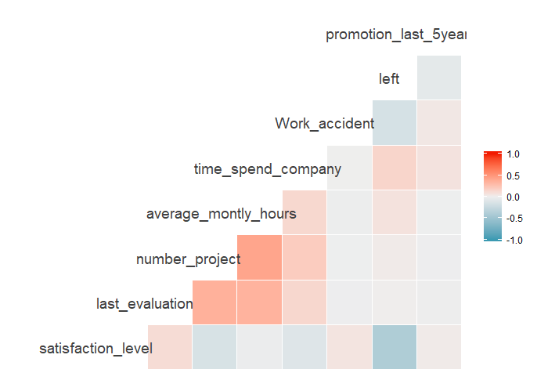
Correlation Plots

Slide 5
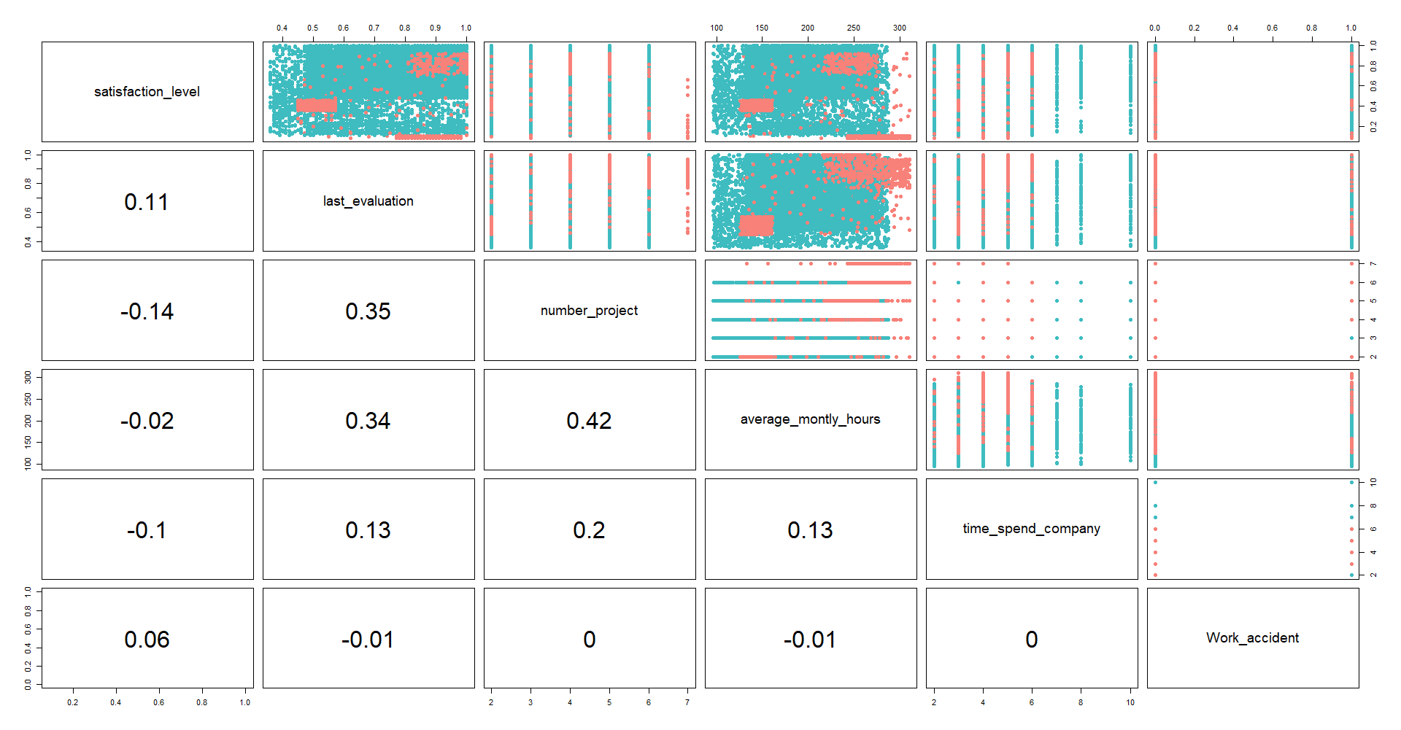

Slide 6
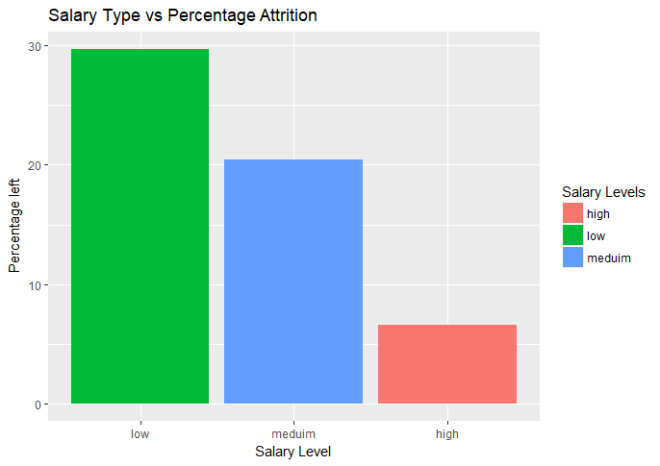
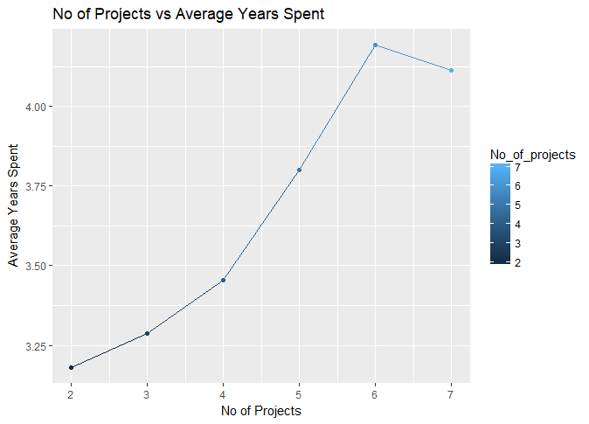
Relationship between No of Projects and the Average Years spent in the Company
Distribution of the Salary Category vs Attrition Percent

Slide 7
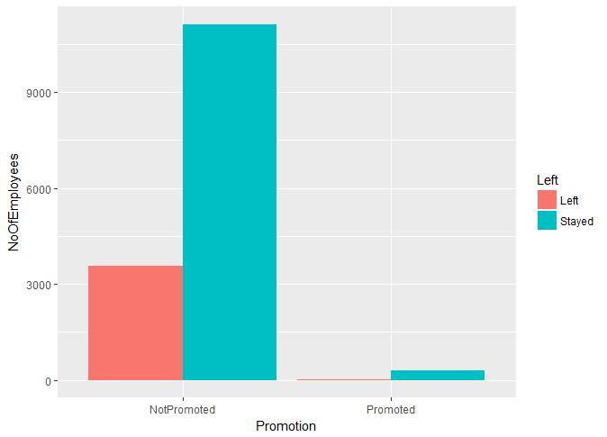
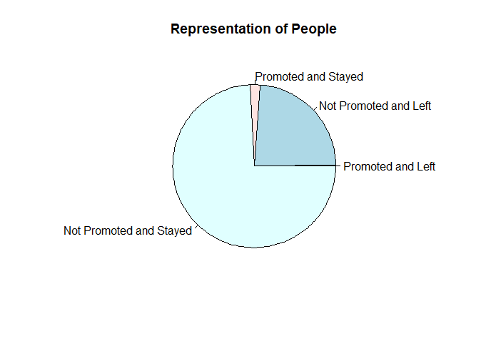
By Promotion in the last 5 years
Almost ¼ th of the people left !

Slide 8
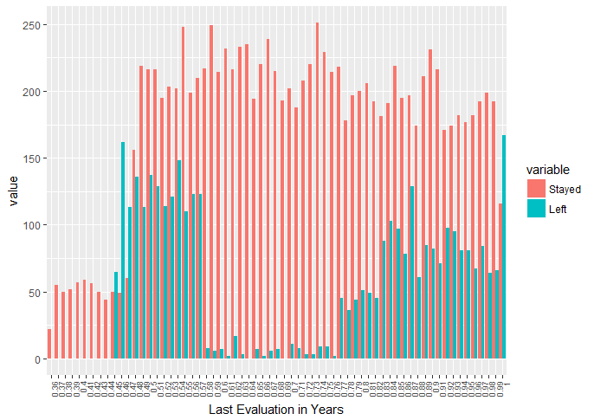
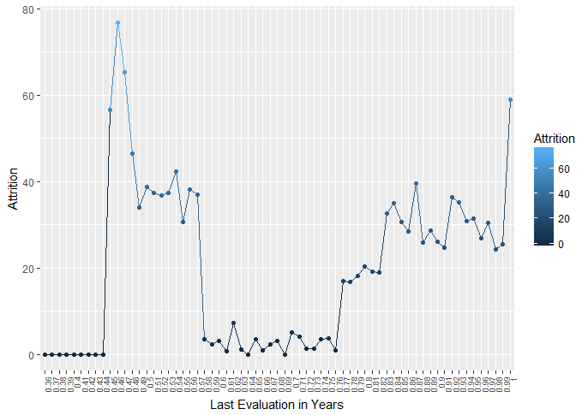
By Last Evaluation

Slide 9
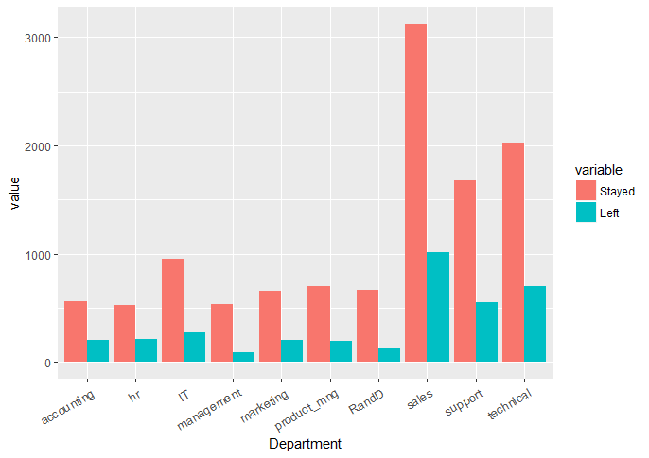
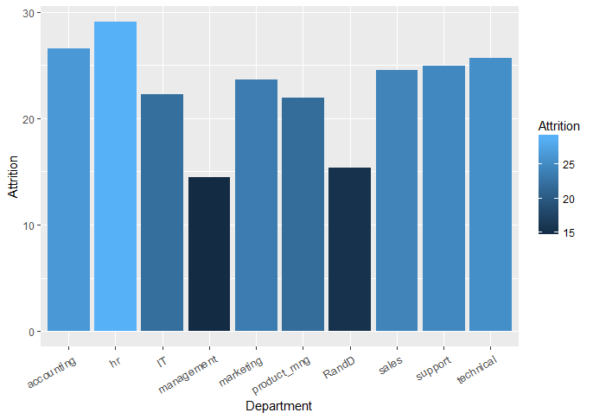
By Department

Slide 10
By Satisfaction Level
Satisfaction Level | Qualitative Equivalent
Greater than 0.8 | Very High
Between 0.6 and 0.8 | High
Between 0.4 and 0.6 | Medium
Between 0.2 and 0.4 | Low
Less than 0.2 | Very Low

Slide 11
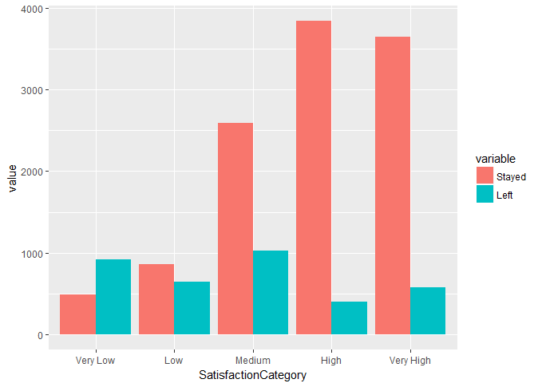
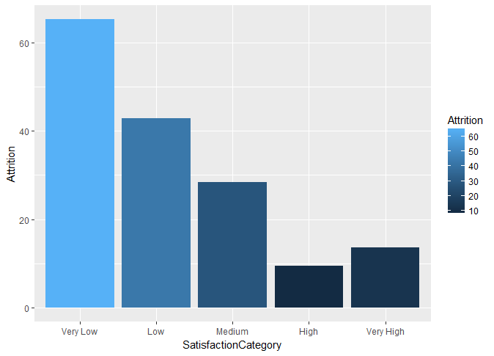

Slide 12
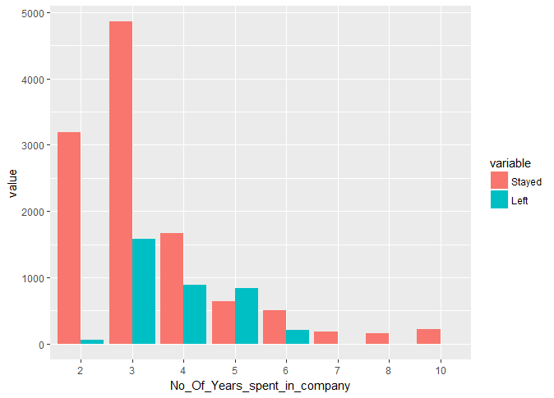
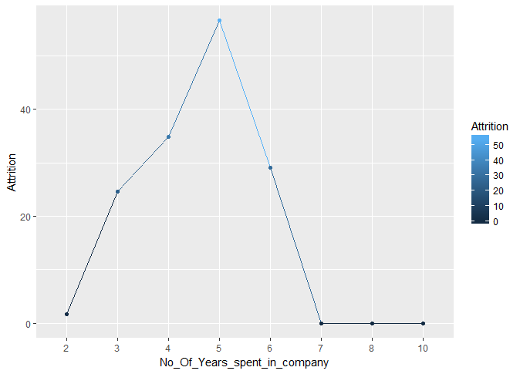
By Number of Years spent in the Company

Slide 13
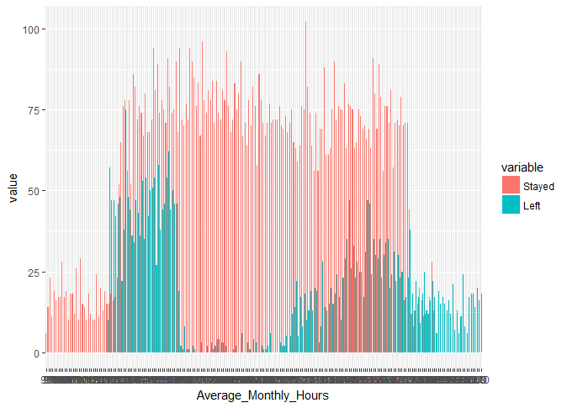
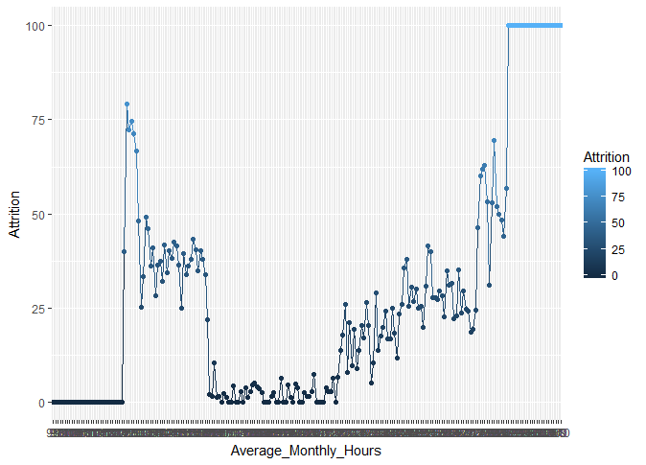
By Average monthly hours spent at Workplace

Slide 14
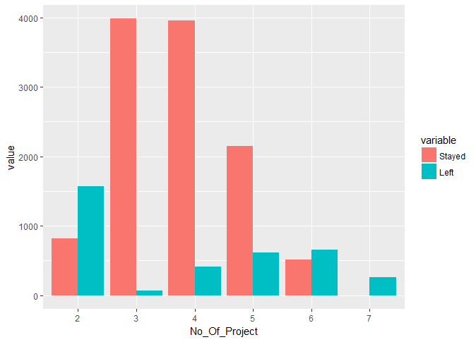
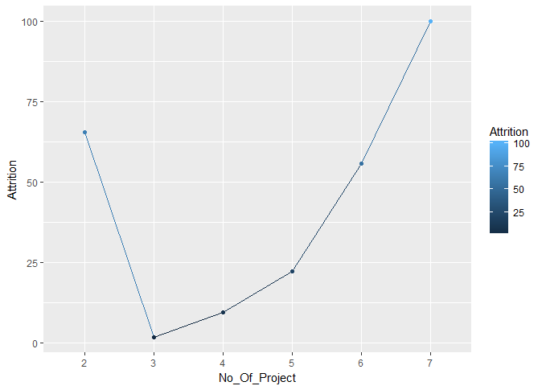
By Number of Projects

Slide 15
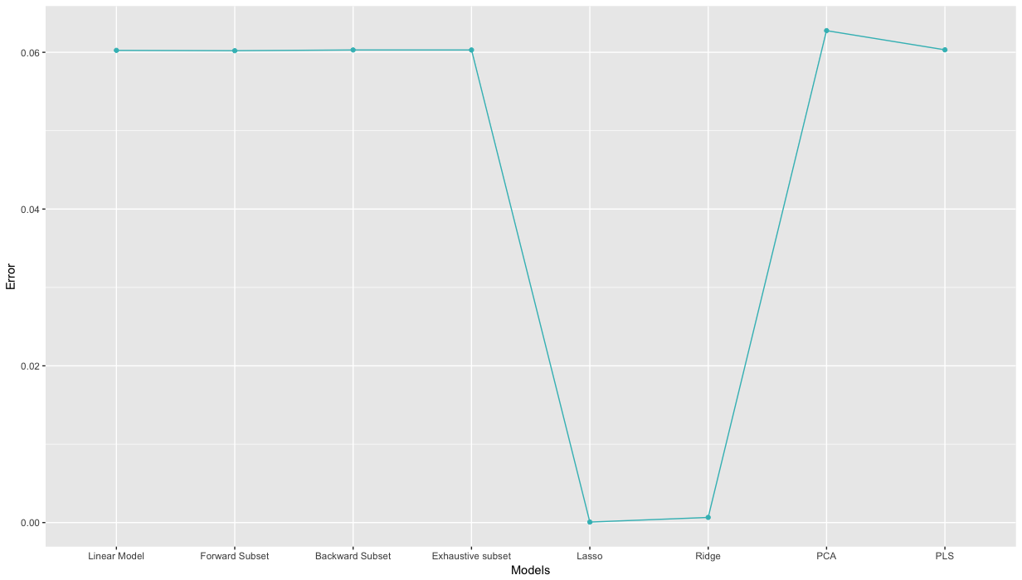
Plot of error :

